Slide 1

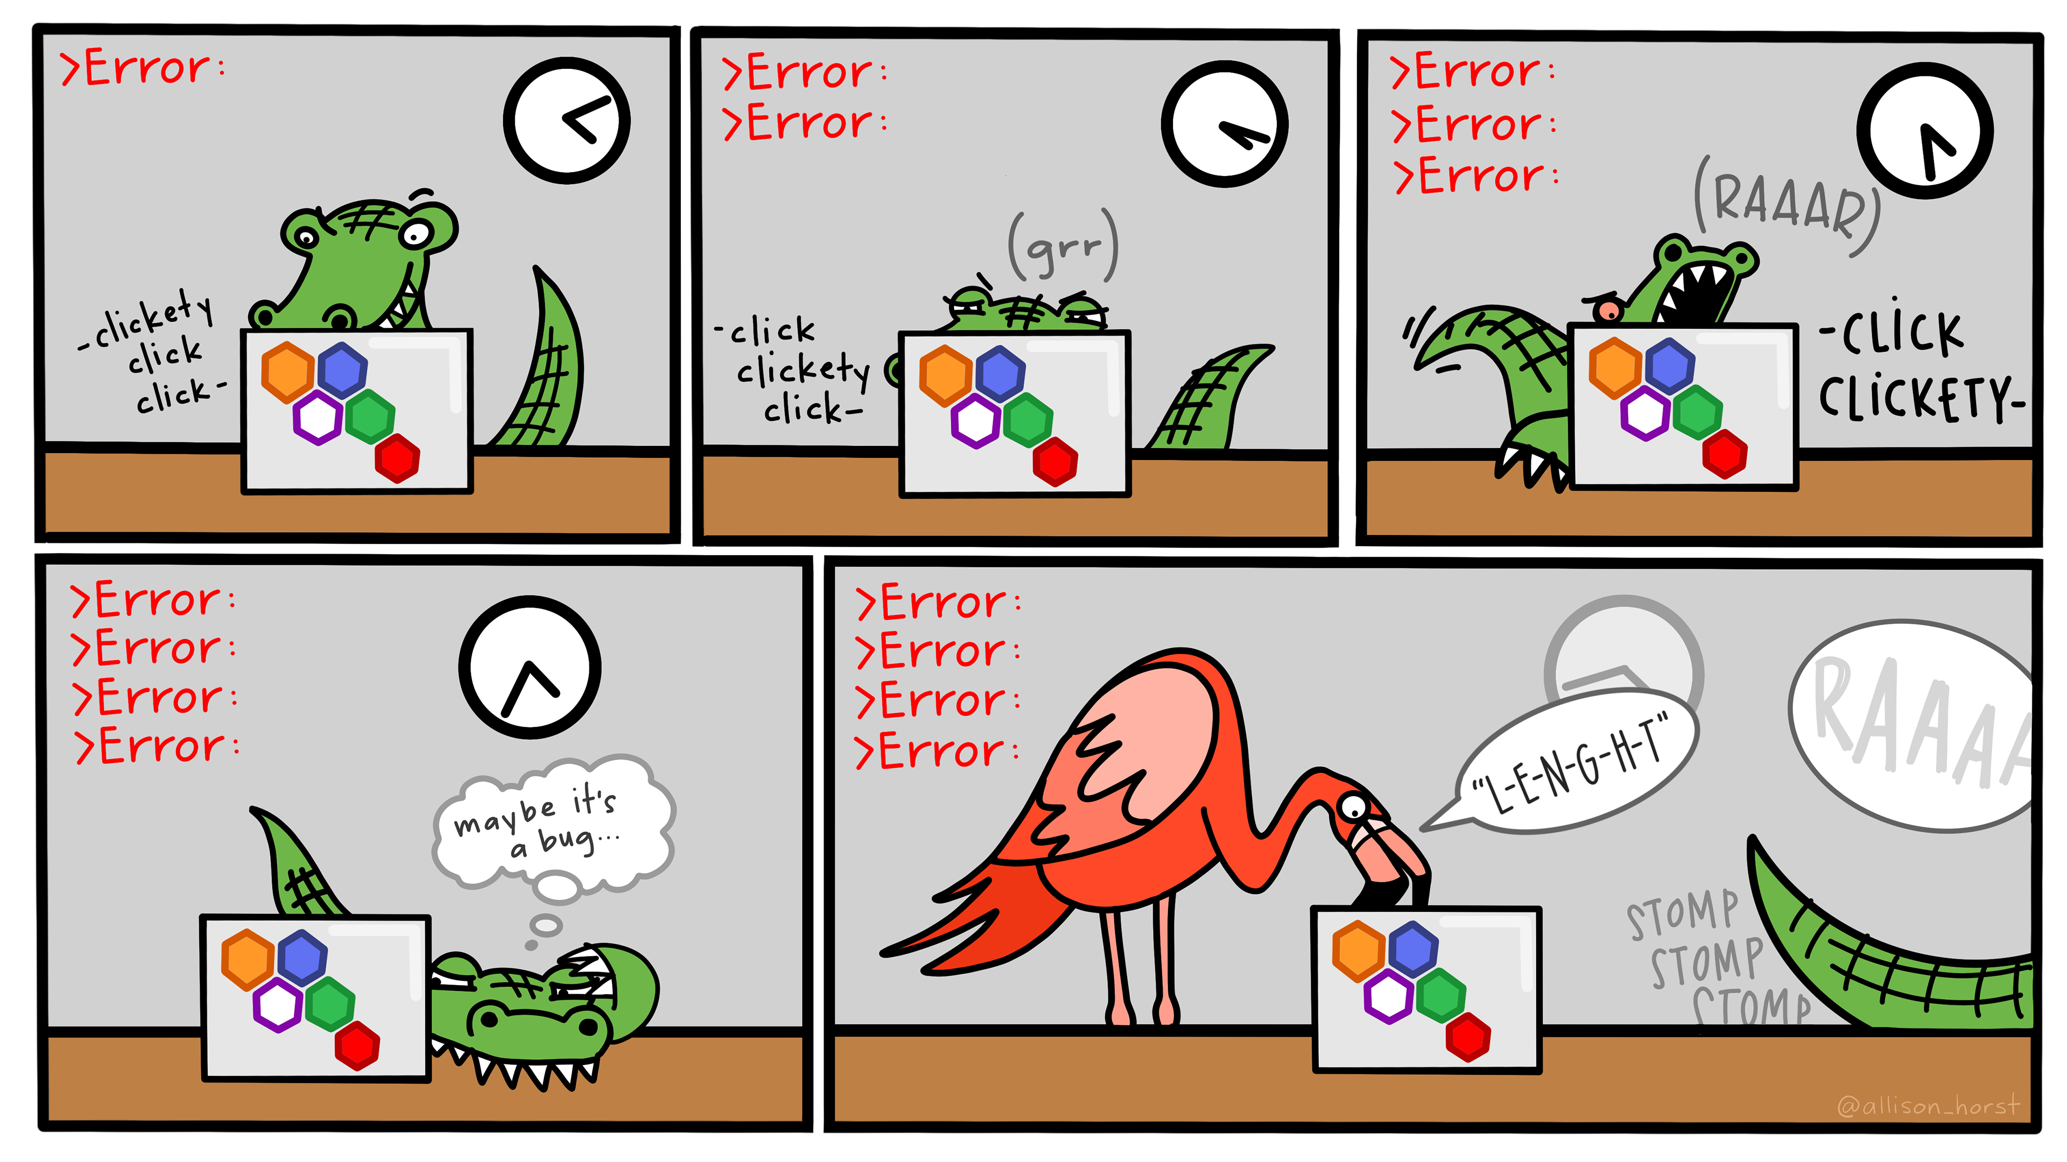

Debugging with VS Code
Artwork by @allison_horst
Notes:
Artwork Source: https://allisonhorst.com/everything-else

Slide 2

Website: www.rc.colorado.edu
Documentation: https://curc.readthedocs.io
Helpdesk: rc-help@colorado.edu
Survey: http://tinyurl.com/curc-survey18
2

Slide 3










Meet the User Support Team
Layla Freeborn
Brandon Reyes
Andy Monaghan
Michael Schneider
John
Reiland
Dylan Gottlieb
Mohal Khandelwal
Ragan
Lee
3

Slide 4
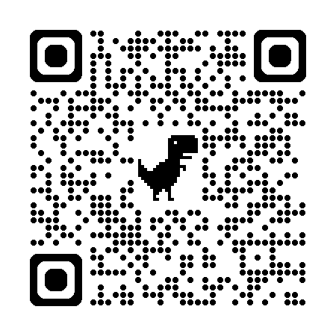
Slides https://github.com/ResearchComputing/debugging_with_vs_code_shortcourse
4

Slide 5
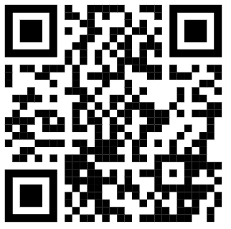
Debugging with VS Code
Instructor:
Research Computing
Website: www.rc.colorado.edu
Helpdesk: rc-help@colorado.edu
Slides:
https://github.com/ResearchComputing/debugging_with_vs_code_shortcourse
Survey:
http://tinyurl.com/curc-survey18
5

Slide 6



Overview
VS Code
6
Notes:
This presentation covers the basics of using VS Code’s (Visual Studio Code) built-in debugger and is divided into three parts:
(1) Demonstrate how to start a VS Code Server through OnDemand - https://ondemand.rc.colorado.edu/pun/sys/dashboard
(2) Provide an overview of VS Code’s user interface
(3) Explain how to prepare and then use the debugger on a Python program

Slide 7
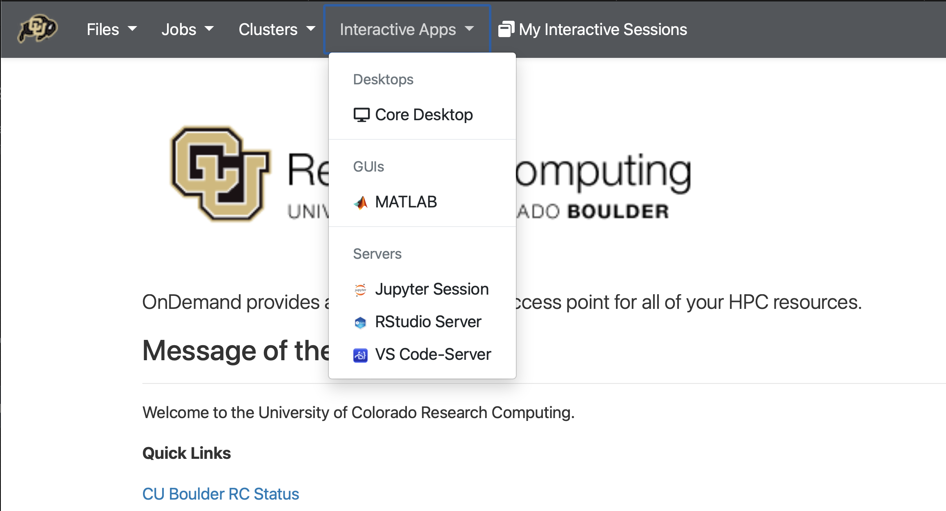
VS Code - OnDemand
1
2
7
Notes:
Open the Interactive Apps dropdown (Top Menu Bar)
Select “VS Code-Server”
Note:
VS Code OnDemand Documentation: https://curc.readthedocs.io/en/latest/gateways/OnDemand.html#vs-code-server

Slide 8
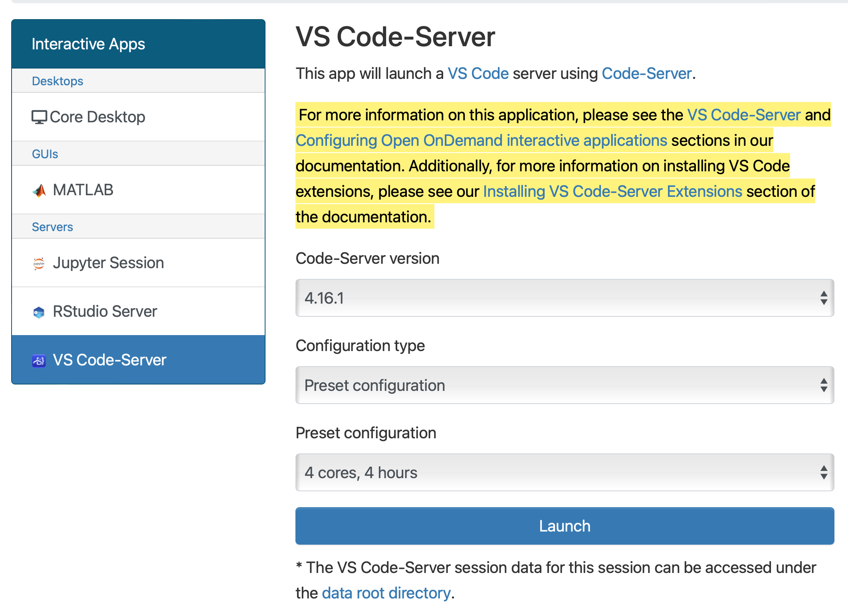
VS Code - OnDemand
3
4
8
Notes:
(3) Select your preferred configuration [4 cores, 4 hours]
(4) Launch the VS Code Server

Slide 9
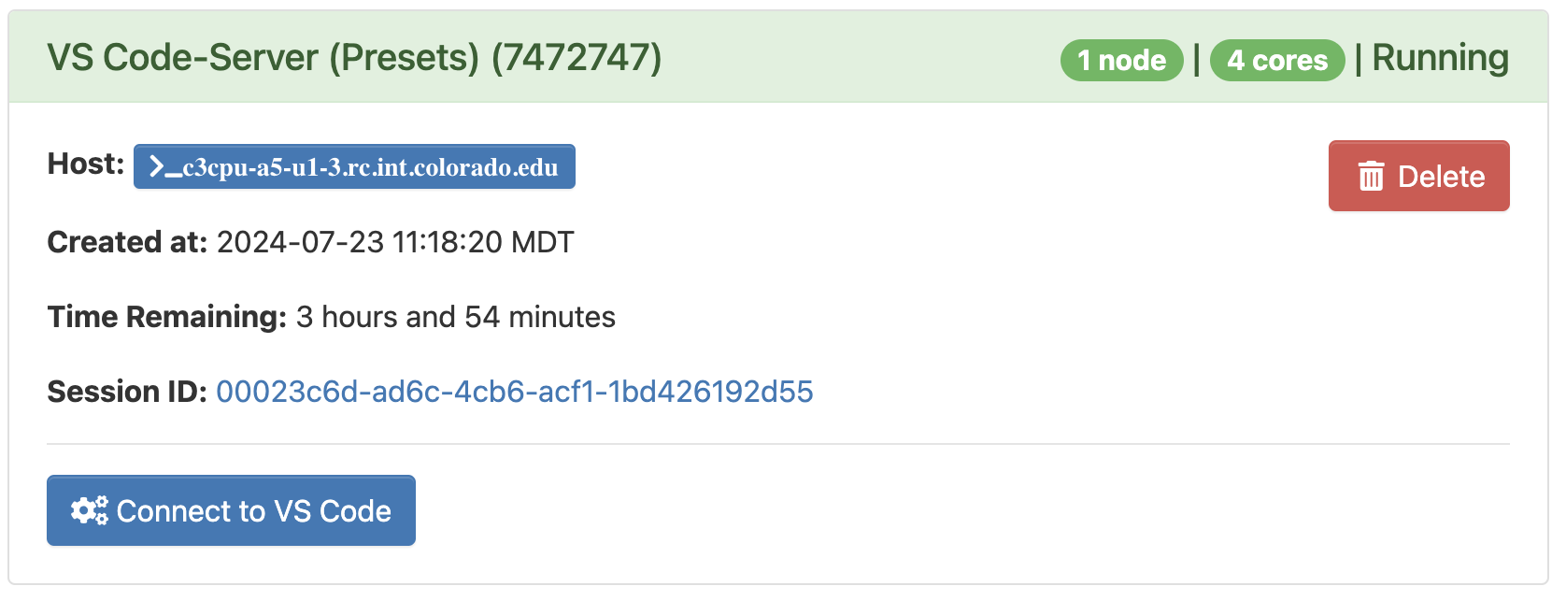
VS Code - OnDemand
5
9
Notes:
(5) Once the server has started, click “Connect to VS Code”

Slide 10
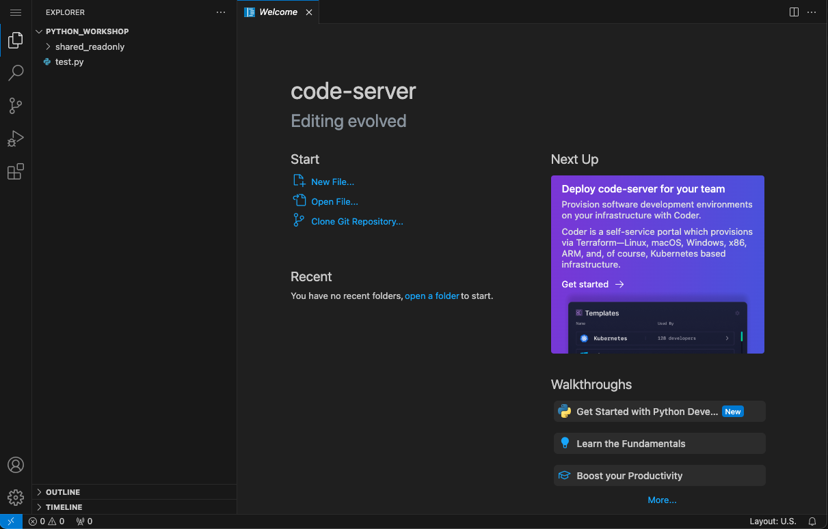
VS Code - OnDemand
10
Notes:
To debug a python program, VS Code will need to have the Python Extension installed.
Extensions can be found by clicking the stack of blocks in the top-left of the user interface.

Slide 11
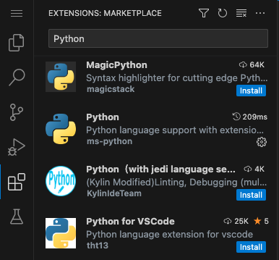
VS Code – Extensions
2
3
1
11
Notes:
Click the “Extensions” tab
Type “Python” into search provided search bar.
Click “Install” next to the Python extension

Slide 12
Example Program
FizzBuzz.py
1
2
3
4
5
6
7
8
9
10
11
12
13
14
15
def Fizz_Buzz(number_to_test):
result = ""
if(number_to_test % 2 == 0):
result += "Fizz"
if(number_to_test % 3 == 0):
result += "Buzz"
return(result)
test_val = 4
test_result = Fizz_Buzz(test_val)
print("Results: " + test_result)
12
Notes:
Copy+paste the FizzBuzz.py’s code into a new file in your VS Code session.
This file is also provided in this presentations Github Repo: https://github.com/ResearchComputing/debugging_with_vs_code_shortcourse

Slide 13


Breakpoints
9 10 test_val = 4
11 12 test_result = Fizz_Buzz(test_val)
13 14 print("Results: ” + test_result)
15
1
13
Notes:
Breakpoints can be used to temporarily pause a program’s execution.
While paused, the state of the program’s data (variables, registers, etc.) can be observed and even modified.
(1) Add a breakpoint on Line 10 test_val=4

Slide 14
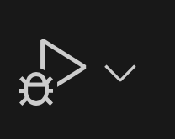
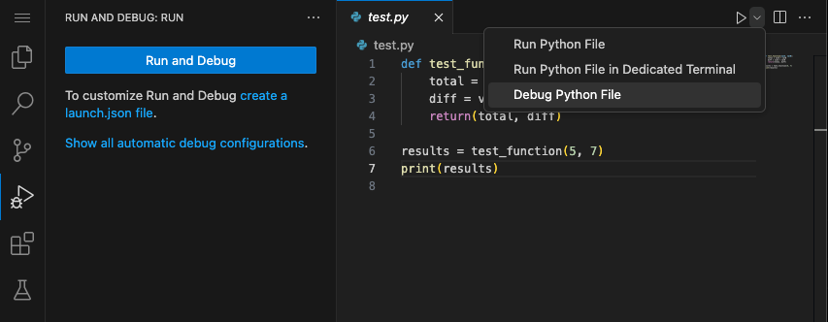
Start the Debugger
2
1
14
Notes:
Click the dropdown and select “Debug Python File”
The “Run” button should be replaced with the “Debug” button

Slide 15
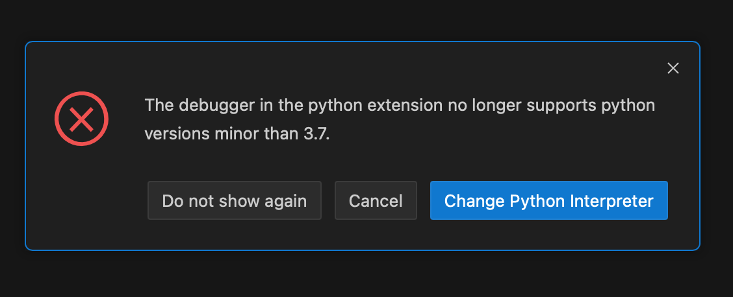
Python Interpreter Error
15
Notes:
The default Python Interpreter for the OnDemand (Viz) nodes is 3.68, which is not supported by the debugger.
If you haven’t set the Python Extension to use a different interpreter (like Anaconda), then you will likely see this error message.

Slide 16
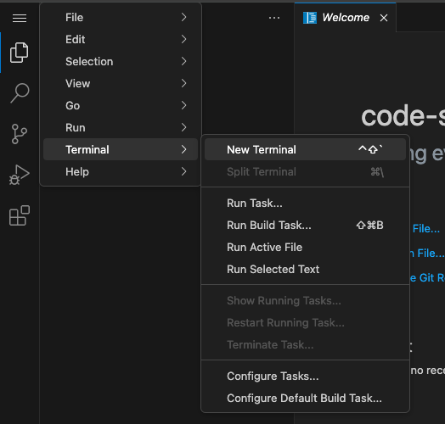
List Python Interpreters
1
2
3
[user]$ python3 --version
Python 3.6.8
[user]$ load anaconda
(base) [user]$ python3 --version
Python 3.11
(base) [user]$ which python3
/anaconda/path-to-python-here
4
5
16
Notes:
To change the Python Interpreter:
(1-3): Open a New Terminal
In the Terminal:
(4) Load anaconda (base environment)
(5) List the file path to the base Anaconda’s python interpreter
*Make sure to copy+paste the file path*

Slide 17


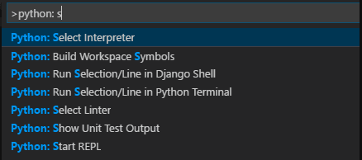
Select Python Interpreter
1
Ctrl + Shift + P
⇧ ⌘ P
2
17
Image Src: Apple Logo, Windows Logo
Notes:
(1) Open the Command Pallete in VS Code (short cut keys for Windows (Left) and Mac (Right)
(2) Pick the python extensions “Select Interpreter” option.
Information on Selecting the Python Interpreter in VS Code:
https://code.visualstudio.com/docs/python/environments#_working-with-python-interpreters

Slide 18
Debugger - Controls

Slide 19
Debugger – Variables Explorer
VARIABLES
Locals
special variables
function variables
test_val: 4
9 10 test_val = 4
11 12 test_result
13 14 print("Resul
15
Globals
19
Notes:
While paused on line 10, the user should see a similar set of variables and values.
Demo: Show how the variables can be viewed and modified.

Slide 20
Debugger - Controls
Continue
Step
Into
20
Notes:
The “Continue” button will move from breakpoint to breakpoint, until reaching the end of the program’s execution (or an error is reached).
The “Step Into” button, enables users to observe the path of a program’s execution line-by-line, including “stepping into” functions called.
Demo: Show how each option affects the execution of the program.

Slide 21
Debugger – Variables Explorer
VARIABLES
Locals
number_to_test: 4
result: ''
1 2 def Fizz_Buz
3 result
4 if(numbe
5 resu
6
Globals
special variables
function variables
test_val: 4
21
Notes:
Once inside the “Fizz_Buzz” method, the variable display will update as shown.
Note how test_val is now listed as a ”Global” and the appearance of the method’s variables, “Local”

Slide 22
Debugger - Controls
Step
Over
Step
Out
22
Notes:
Step Over – This button enables for coding stepping that stays in the current scope – e.g. no stepping into a method call, loop, or conditional statement
Step Out – This button continues code execution and pauses at the calling/higher level of scope – e.g. the point where a method was call, the end of a loop, or outside a conditional statement.

Slide 23
Debugger - Controls
Restart
Stop
23
Notes:
Restart – This button will end the program’s execution and then start over
Stop – This will stop both the program’s execution and the debugger
*Key warning – Any changes made to variables within the debugger are only temporary. That’s great for testing, but does mean the data will be gone when restarting or stopping a debugging session*

Slide 24
Debugger – Watch Expressions
WATCH
number_to_test % 2 == 0: True
1 def Fizz_Buzz(number_to_test):
2 result = ""
3 if(number_to_test % 2 == 0):
4 result += "Fizz"
5 6 if(number_to_test % 3 == 0):
7 result += "Buzz"
8 return(result)
9 10 test_val = 4
11 12 test_result = Fizz_Buzz(test_val)
13 14 print("Results: " + test_result)
24
Notes:
Individual variables (e.g. an object’s field) or programmatic expressions can be observed with the “Watch” feature.
The variables or expression being watched will be automatically updated, always providing an up-to-date view of system information.

Slide 25
Debugger – Watch Expressions
WATCH
number_to_test % 2 == 0: Error Undefined
1 def Fizz_Buzz(number_to_test):
2 result = ""
3 if(number_to_test % 2 == 0):
4 result += "Fizz"
5 6 if(number_to_test % 3 == 0):
7 result += "Buzz"
8 return(result)
9 10 test_val = 4
11 12 test_result = Fizz_Buzz(test_val)
13 14 print("Results: " + test_result)
25
Notes:
Be mindful, you will often run into “Undefined” errors with watchlists because the variables used are no longer in-scope.

